Slide 1
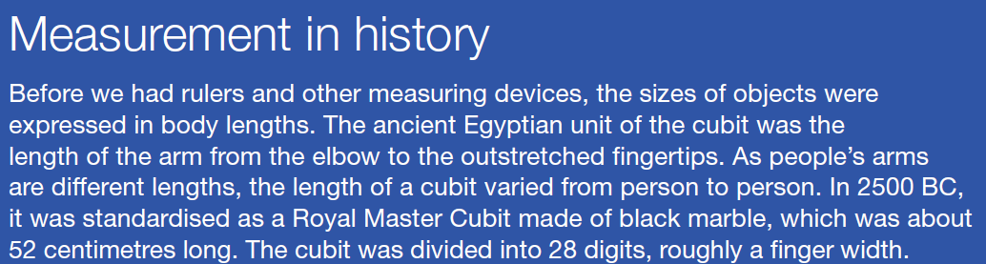
Hook
Measurements are used in many areas of design today. Buildings, clothes and footy
banners can be designed using areas of colour in a Mondrian-type format. Mondrianstyle
patterns appear in nature, for example in the wings of a butterfly. Stained glass
windows have blocks of colour surrounded by strong lines. How would you estimate
the area of each of the blocks of colour?

Slide 2
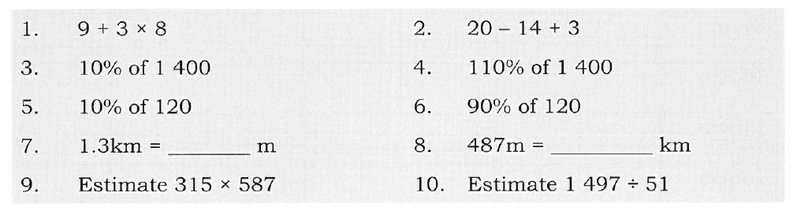
Warm Up

Slide 3
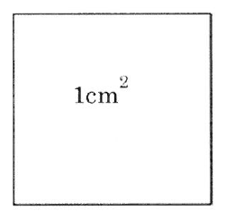

□ 24
□ 7
□ 30
Title: Area, Volume and capacity
Date 27/02/2017
EQ – How do we find the area of flat shapes and convert units of area

Slide 4
□ 24
□ 7
□ 30
Title: Area, Volume and capacity
Date 27/02/2017
EQ – How do we find the area of flat shapes and convert units of area

Slide 5
□ 24
□ 7
□ 30
Title: Area, Volume and capacity
Date 27/02/2017
EQ – How do we find the area of flat shapes and convert units of area
The area of a shape is the amount of space inside that shape.
A rule can be used to find the area of a rectangle.
Simply multiply the length by the width.
Make sure that the measurements for length and width have the same units. The units for area are squared, for example square centimetres or cm2, because area has two dimensions.

Slide 6
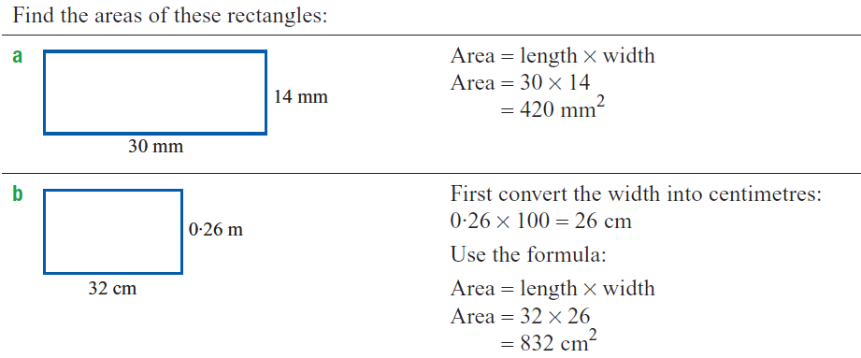
□ 24
□ 7
□ 30
Title: Area, Volume and capacity
Date 27/02/2017
EQ – How do we find the area of flat shapes and convert units of area

Slide 7
Task
Page 47 Questions 1 to 7 show full working.

Slide 8
Notes Review
24, 7 ,30
Date
Title
Essential question
Notes complete
Notes complete with colour and diagrams
Questions completed
Contents page filed in
Formula page filled in

Slide 9
Homework
Review your notes and write a summary answering the essential question.

